Slide 1

Apex Institute of Technology
Department of Computer Science & Engineering
Bachelor of Engineering (Computer Science & Engineering)
Design and Analysis of Algorithms– (20CSH-282)
Prepared By: Mr. Vikas Kumar (E13657)
DISCOVER . LEARN . EMPOWER

Slide 2
Content
Sorting: Quick Sort
Heap sort.
Sorting: 2-Way Merge Sort

Slide 3
Heap Sort
A Heap is a special Tree-based data structure in which the tree is a complete binary tree.
Generally, Heaps can be of two types:
Max-Heap: In a Max-Heap the key present at the root node must be greatest among the keys present at all of its children. The same property must be recursively true for all sub-trees in that Binary Tree.
Min-Heap: In a Min-Heap the key present at the root node must be minimum among the keys present at all of its children. The same property must be recursively true for all sub-trees in that Binary Tree.

Slide 4
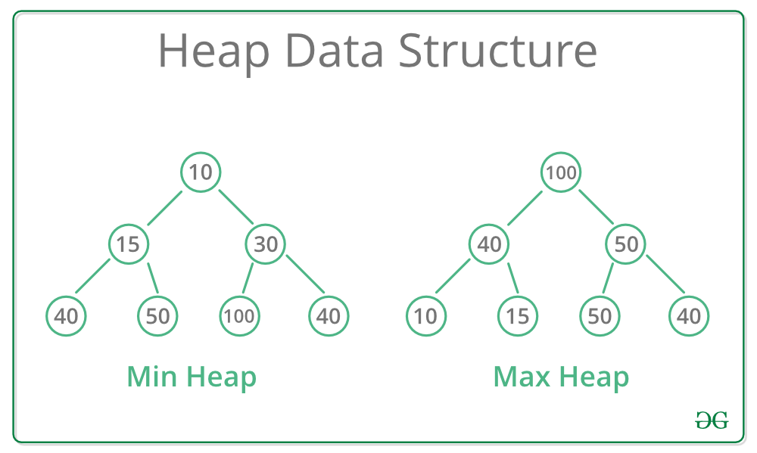
Heap

Slide 5
Operation/Methods on Heap
find - find an item in a heap.
insert - add an item in a heap ensuring the heap property is maintained min-heap and max-heap property.
Delete - remove an item from a heap.
Extract - return the value of an item and then delete it from the heap.
replace - extract or pop the root and insert or push a new item in a heap ensuring the heap property has maintained min-heap and max-heap properties.

Slide 6
Methods/Operations of Heap (Contd..)
Apart from the previously mentioned basic operations, there are other operations such as:
size - returns the size of the heap.
is-empty - returns 'true' if the heap is empty or 'false' if it has value.
merge - joining or union of two heaps, all the values from both heaps are included but the original heaps are preserved.
meld - joining of two heaps where the values from both heaps are included but the original heaps are destroyed.

Slide 7
Heap Tree Representation
PARENT (i) => return [ i /2]
LEFT (i) => return 2i
RIGHT (i) => return 2i+ 1

Slide 8
Maintaining the heap property
MAX-HEAPIFY(A,i)
1. l LEFT(i)
2. r RIGHT(i)
3. if A[l] > A[i]
4. largest l
5. if A[r] > A[largest]
6. Largest r
7. if largest != i
8. Then exchange A[i] A[largest]
9.MAX-HEAPIFY(A,largest)
The running time of MAX-HEAPIFY by the recurrence can be described as
T (n) < = T (2n/3) + O (1)
The solution to this recurrence is T(n)=O(log n)

Slide 9
Build Heap Tree
Build-Max-Heap(A)
1. for i[n/2] to 1
2. do
MAX-HEAPIFY(A,i)
4 | 1 | 3 | 2 | 1 | 9 | 1 | 1 | 8 | 7

Slide 10
Build Heap Tree
The total cost of BUILD-MAX-HEAP as being bounded is T(n)=O(n)

Slide 11
The HEAPSORT Algorithm
HEAPSORT(A)
1. BUILD MAX-HEAP(A)
2. for i=n to 2
3. exchange A[1] with A[i]
4. MAX-HEAPIFY(A,1)

Slide 12
HEAPSORT Algorithm
1 2 3 4 7 8 9 10 14 16

Slide 13
Complexity for Heap
The HEAPSORT procedure takes time O(n log n) since the call to BUILD-MAX-HEAP takes time O(n) and each of the n - 1 calls to MAX-HEAPIFY takes time O(log n).The

Slide 14
Quick Sort
Another Divide-and-Conquer sorting algorithm…
As it turns out, MERGESORT and HEAPSORT, although O(n log n) in their time complexity, have fairly large constants and tend to move data around more than desirable (e.g., equal-key items may not maintain their relative position from input to output).
We introduce another algorithm with better constants, but a flaw: its worst case is O(n²). Fortunately, the worst case is “rare enough” so that the speed advantages work an overwhelming amount of the time… and it is O(n log n) on average.
Quick sort is also known as partition exchange sort.

Slide 15
Quick Sort Approach
Like in MERGESORT, we use Divide-and-Conquer:
Divide: partition A[p..r] into two subarrays A[p..q-1] and A[q+1..r] such that each element of A[p..q-1] is ≤ A[q], and each element of A[q+1..r] is ≥ A[q]. Compute q as part of this partitioning.
Conquer: sort the subarrays A[p..q-1] and A[q+1..r] by recursive calls to QUICKSORT.
Combine: the partitioning and recursive sorting leave us with a sorted A[p..r] – no work is needed here.
An obvious difference is that we do most of the work in the divide stage, with no work at the combined one.

Slide 16
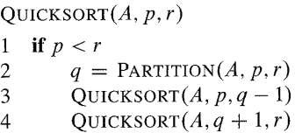
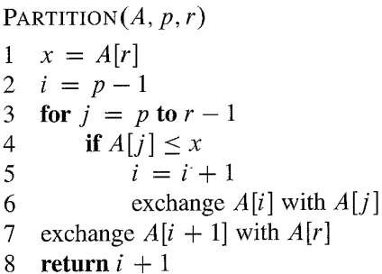
Quick Sort Algo

Slide 17
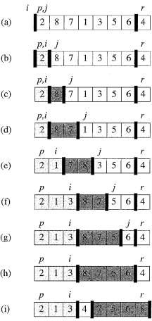
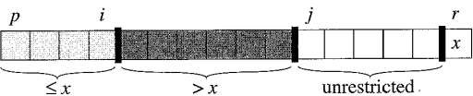
Quick Sort Algo example

Slide 18
Quick Sort Algo example
p r
initially: 2 5 8 3 9 4 1 7 10 6 note: pivot (x) = 6
i j
next iteration: 2 5 8 3 9 4 1 7 10 6
i j
next iteration: 2 5 8 3 9 4 1 7 10 6
i j
next iteration: 2 5 8 3 9 4 1 7 10 6
i j
next iteration: 2 5 3 8 9 4 1 7 10 6
i j
Partition(A, p, r)
x, i := A[r], p – 1;
for j := p to r – 1 do
if A[j] ≤ x then
i := i + 1;
A[i] ↔ A[j]
A[i + 1] ↔ A[r];
return i + 1

Slide 19
Quick Sort Algo example
next iteration: 2 5 3 8 9 4 1 7 10 6
i j
next iteration: 2 5 3 8 9 4 1 7 10 6
i j
next iteration: 2 5 3 4 9 8 1 7 10 6
i j
next iteration: 2 5 3 4 1 8 9 7 10 6
i j
next iteration: 2 5 3 4 1 8 9 7 10 6
i j
next iteration: 2 5 3 4 1 8 9 7 10 6
i j
after final swap: 2 5 3 4 1 6 9 7 10 8
i j
Partition(A, p, r)
x, i := A[r], p – 1;
for j := p to r – 1 do
if A[j] ≤ x then
i := i + 1;
A[i] ↔ A[j]
A[i + 1] ↔ A[r];
return i + 1

Slide 20
Correctness of Partition Correctness of Partition
Use loop invariant.
Initialization:
Before the first iteration
A[p..i] and A[i+1..j – 1] are empty – Conditionss. 1 and 2 are satisfied (trivially).
r is the index of the pivot
Condition 3 is satisfied.
Partition(A, p, r)
x, i := A[r], p – 1;
for j := p to r – 1 do
if A[j] ≤ x then
i := i + 1;
A[i] ↔ A[j]
A[i + 1] ↔ A[r];
return i + 1

Slide 21
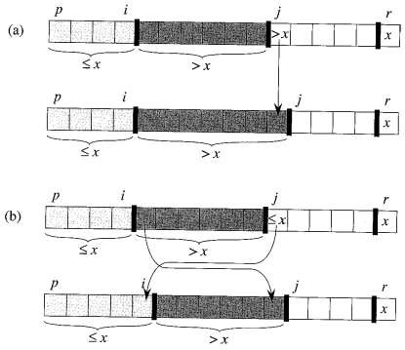
Maintenance:
Case 1: A[j] > x
Increment j only.
Loop Invariant is maintained
Case 2: A[j] ≤ x
Increment i
Swap A[i] and A[j]
Condition 1 is maintained.

Slide 22
QUICKSORT: Performance – a quick look.
(apparent) worst-case partitioning:
T(n) = T(n-1) + T(0) + Θ(n) = T(n-1) + Θ(n).
It is easy to show – using substitution - that T(n) = Θ(n²).
We next look at (apparent) best-case partitioning:
T(n) = 2T(n/2) + Θ(n).
It is also easy to show (case 2 of the Master Theorem) that T(n) = Θ(n log n).

Slide 23
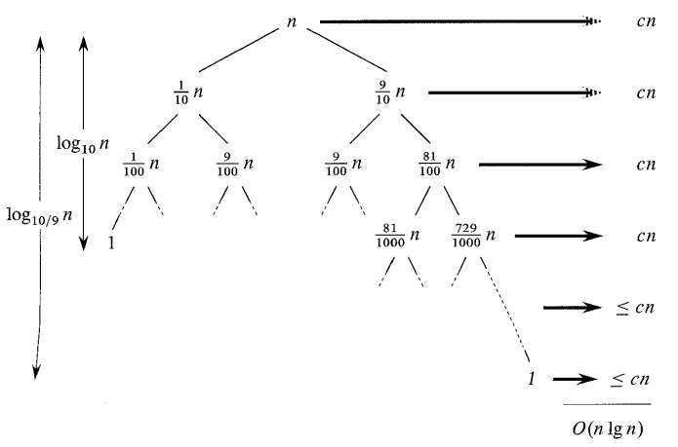
QUICKSORT: Performance – Balanced Partitioning

Slide 24
Best Case Analysis(Recursive)
We cut the array size in half each time
So the depth of the recursion in log₂n
At each level of the recursion, all the partitions at that level do work that is linear in n
O(log₂n) * O(n) = O(n log₂n)
Hence in the best case, quicksort has time complexity O(n log₂n)
What about the worst case?

Slide 25
Worst case Analysis
In the worst case, partitioning always divides the size n array into these three parts:
A length of one part, containing the pivot itself
A length zero part, and
A length n-1 part, containing everything else
We don’t recur on the zero-length part
Recurring on the length n-1 part requires (in the worst case) recurring to depth n-1

Slide 26
Worst case Analysis
In the worst case, recursion may be n levels deep (for an array of size n)
But the partitioning work done at each level is still n
O(n) * O(n) = O(n²)
So the worst case for Quicksort is O(n²)
When does this happen?
There are many arrangements that could make this happen
Here are two common cases:
When the array is already sorted
When the array is inversely sorted (sorted in the opposite order)

Slide 27
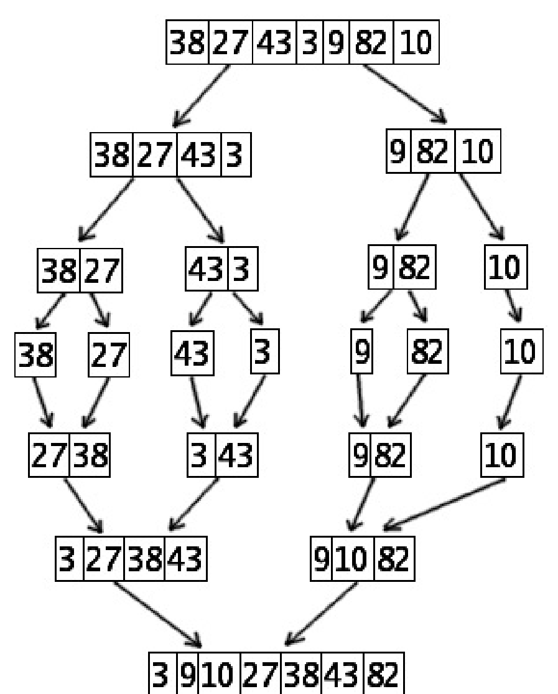
Merge Sort Example

Slide 28
Merge-Sort (A, p, r)
INPUT: a sequence of n numbers stored in array A OUTPUT: an ordered sequence of n numbers
MergeSort (A, p, r) // sort A[p..r] by divide & conquer
1 if p < r
2 then q ← ⎣(p+r)/2⎦
MergeSort (A, p, q)
MergeSort (A, q+1, r)
Merge (A, p, q, r) // merges A[p..q] with A[q+1..r]
Initial Call: MergeSort(A, 1, n)

Slide 29
Procedure Merge
Merge(A, p, q, r)
1 n₁ ← q – p + 1
2 n₂ ← r – q
Input: Array containing sorted subarrays A[p..q] and A[q+1..r].
Output: Merged sorted subarray in A[p..r].
3 for i ← 1 to n₁
4 do L[i] ← A[p + i – 1]
5for j ← 1 to n₂
6do R[j] ← A[q + j]
7 L[n₁+1] ← ∞
8 R[n₂+1] ← ∞
9 i ← 1
10 j ← 1
Sentinels, to avoid having to check if either subarray is fully copied at each step.
11for k ←p to r 12do if L[i] ≤ R[j] 13then A[k] ← L[i]
14 i ← i + 1
15 else A[k] ← R[j]
16 j ← j + 1

Slide 30
Merge Sort
Merge(A, p, q, r)
1 n₁ ← q – p + 1
2 n₂ ← r – q
Loop Invariant for the for loop At the start
of each iteration of the for loop:
Subarray A[p..k – 1] contains the k – p smallest elements of L and R in sorted order. L[i] and R[j] are the smallest elements of L and R that have not been copied back into A.
3 for i ← 1 to n₁
4 do L[i] ← A[p + i – 1]
5for j ← 1 to n₂
6do R[j] ← A[q + j]
7 L[n₁+1] ← ∞
Initialization:
Before the first iteration:
A[p..k – 1] is empty.
i = j = 1.
L[1] and R[1] are the smallest
elements of L and R not copied to A.
8 R[n₂+1] ← ∞
9 i ← 1
10 j ← 1
11for k ←p to r 12do if L[i] ≤ R[j] 13then A[k] ← L[i]
14 i ← i + 1
15 else A[k] ← R[j]
16 j ← j + 1

Slide 31
Merge Sort
Merge(A, p, q, r)
1 n₁ ← q – p + 1
2 n₂ ← r – q
Maintenance:
Case 1: L[i] ≤ R[j]
By LI, A contains p – k smallest elements of L and R in sorted order.
By LI, L[i] and R[j] are the smallest elements of L and R not yet copied into A.
Line 13 results in A containing p – k + 1 smallest elements (again in sorted order). Incrementing i and k reestablishes the LI for the next iteration.
Similarly for L[i] > R[j].
3 for i ← 1 to n₁
4 do L[i] ← A[p + i – 1]
5for j ← 1 to n₂
6do R[j] ← A[q + j]
7 L[n₁+1] ← ∞
8 R[n₂+1] ← ∞
9 i ← 1
10 j ← 1
Termination:
On termination, k = r + 1.
By LI, A contains r – p + 1 smallest elements of L and R in sorted order.
L and R together contain r – p + 3 elements. All but the two sentinels have been copied back into A.
11for k ←p to r 12do if L[i] ≤ R[j] 13then A[k] ← L[i]
14 i ← i + 1
15 else A[k] ← R[j]
16 j ← j + 1

Slide 32
Analysis of Merge Sort
 Running time T(n) of Merge Sort:
 Divide: computing the middle takes Θ(1)
 Conquer: solving 2 subproblems takes 2T(n/2)
 Combine: merging n elements takes Θ(n)
 Total:
T(n) = Θ(1) if n = 1
T(n) = 2T(n/2) + Θ(n) if n > 1
⇒ T(n) = Θ(n lg n)

Slide 33
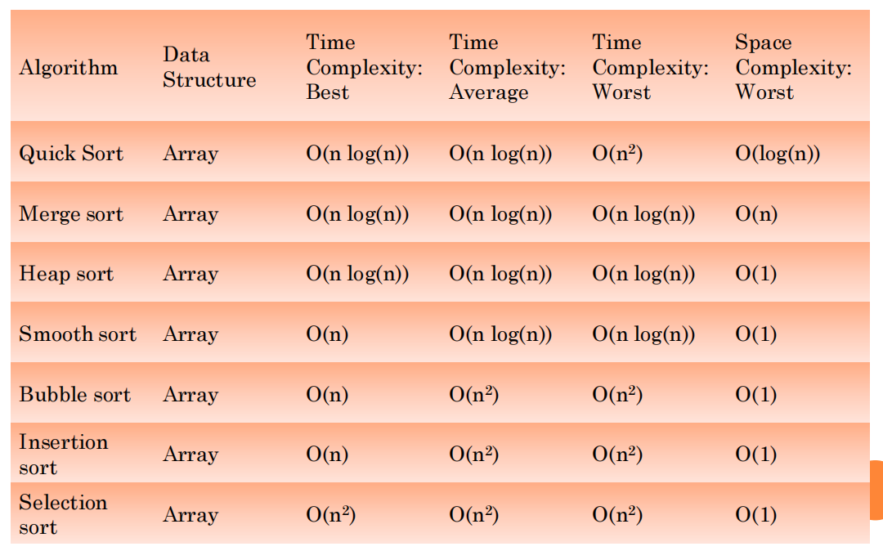
SORTING ALGORITHMS

Slide 34
TASKS END OF LECTURE LEARNING (TELL):
TASK 1:
Write an iterative version of the recursive Quicksort algorithm.
TASK 2:
Iterative Merge Sort Algorithm (Bottom-up Merge Sort)
TASK 3:
Given an array, find the total number of inversions of it. If (i < j) and (A[i] > A[j]), then pair (i, j) is called an inversion of an array A. We need to count all such pairs in the array using merge sort.

Slide 35
References
Fundamentals of Computer Algorithms 2nd Edition (2008) by Horowitz, Sahni and Rajasekaran
Introduction to Algorithms 3rd Edition (2012) by Thomas H Cormen, Charles E Lieserson, Ronald

Slide 36
THANK YOU
For queries
Email: vikash.e13657@cumail.in

